Slide 1

Retail Transaction Dataset
Data Analytics | Cohort 24
Portfolio Project 2
Presented By
Sadia Moeed
Jan 2020 – May 2024

Slide 2
Purchase Cost: $5 – $100 per transaction
1 Million Transactions | 13 Columns
Cities
10
Store Types
08
Payment Methods
04
Store Types
08

Slide 3
Assumptions
Dataset is synthetic, generated using Python Faker library
Transaction_ID is unique identifier, not time-ordered
Date column is only reliable time-based column
Product column may need recalculation for total items

Slide 4


Insights on Cities and Payment Methods
1. How are transactions distributed across cities?
2. Are payment methods used uniformly?
3. Does payment method usage vary across store types?
Dallas and Boston have slightly higher transaction counts (~10.06%)
Usage is fairly uniform, consistent across the dataset
Payment methods show no significant variation across store types, Likely due to synthetic nature of the dataset

Slide 5
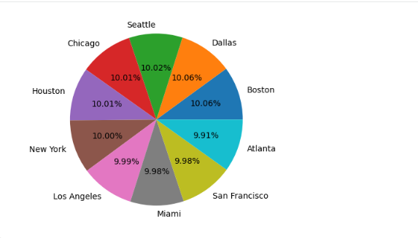
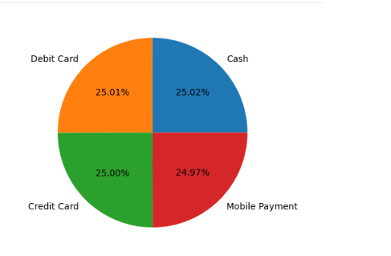
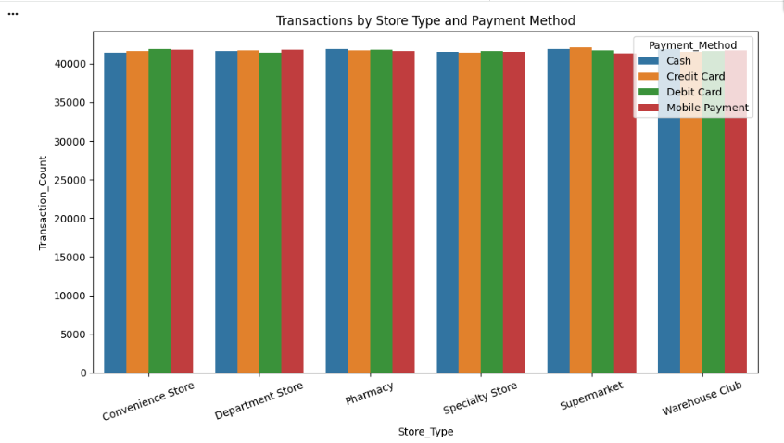
Visual Snapshots

Slide 6

Discounts & Promotions Analysis
Seasonal Discount Pattern
Discounts are highest at the start of the year to clear previous stock for new inventory. For 2024, discounts appear lowest in May because the dataset only includes transactions up to that month.
1. Discount Trends Over Time
Highest discounted transactions: Jan-2020 → 9,895 transactions
Lowest discounted transactions: May-2024 → 5,542 transactions
2. Discounts vs Promotion Types:
Distribution across BOGO, Discount on Selected Items, and No Promotion is fairly uniform
Indicates discounts are not strongly tied to promotions in this dataset

Slide 7
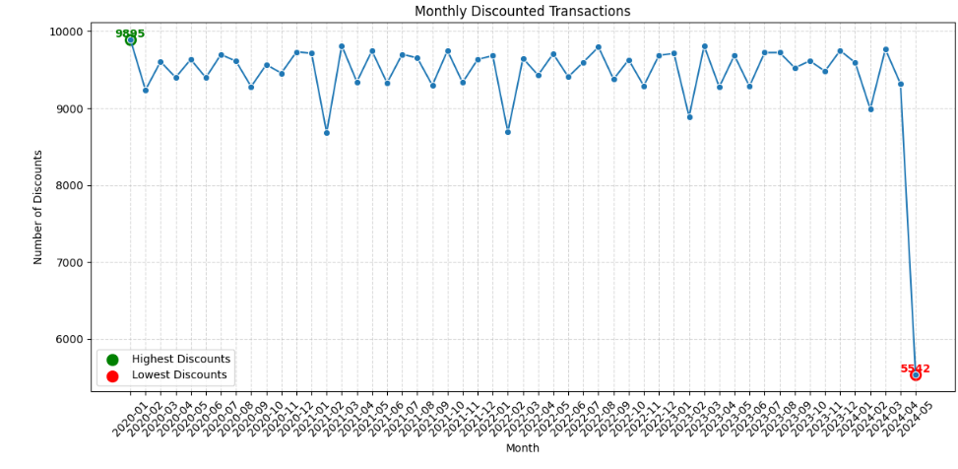
Visual Snapshot

Slide 8
Sales Analysis
1. When do sales peak and dip each year?
2. Are there seasonal patterns or periodic trends?
3. Do low-sales months reflect performance issues or calendar effects?
March 2023 had the highest sales (~$1,033,557) while May 2024 had the lowest (~$586,965), showing significant month-to-month fluctuations.
Peak sales months vary each year (e.g., Jan 2020, Oct 2021, Mar 2023), but low-sales months mostly occur early in the year
February consistently shows lower total sales due to fewer days in the month, not due to performance issues; daily sales remain consistent.

Slide 9
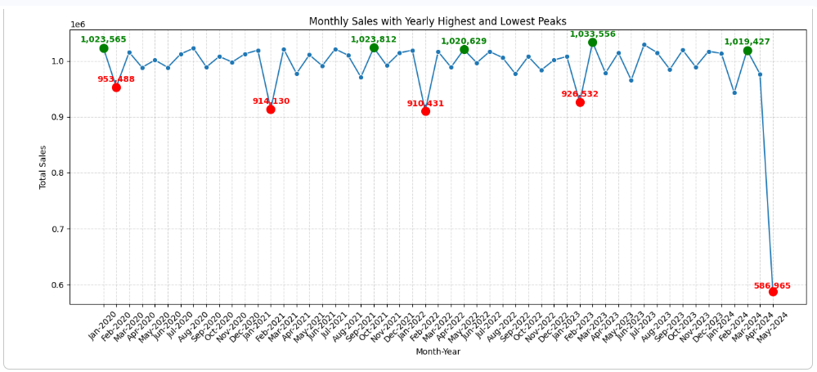
Visual Snapshot

Slide 10
Conclusion
RFM Analysis Insights
Conducted at the customer category level due to the absence of unique customer IDs, RFM analysis identified Homemakers as high-value customers, while Middle-Aged and Professionals may benefit from targeted engagement strategies like loyalty programs or personalized offers to improve purchase frequency and spending.
Market Basket Analysis Insights
Although 80% of transactions contain two or more items, the occurrence of specific multi-item combinations is sparse, making repeated patterns rare. As a result, no frequent multi-item itemsets met the minimum support threshold, and meaningful association rules could not be generated. This indicates that while customers often buy multiple items, the variety of combinations is high.

Slide 11

Thank You
Any Questions?

